Slide 1
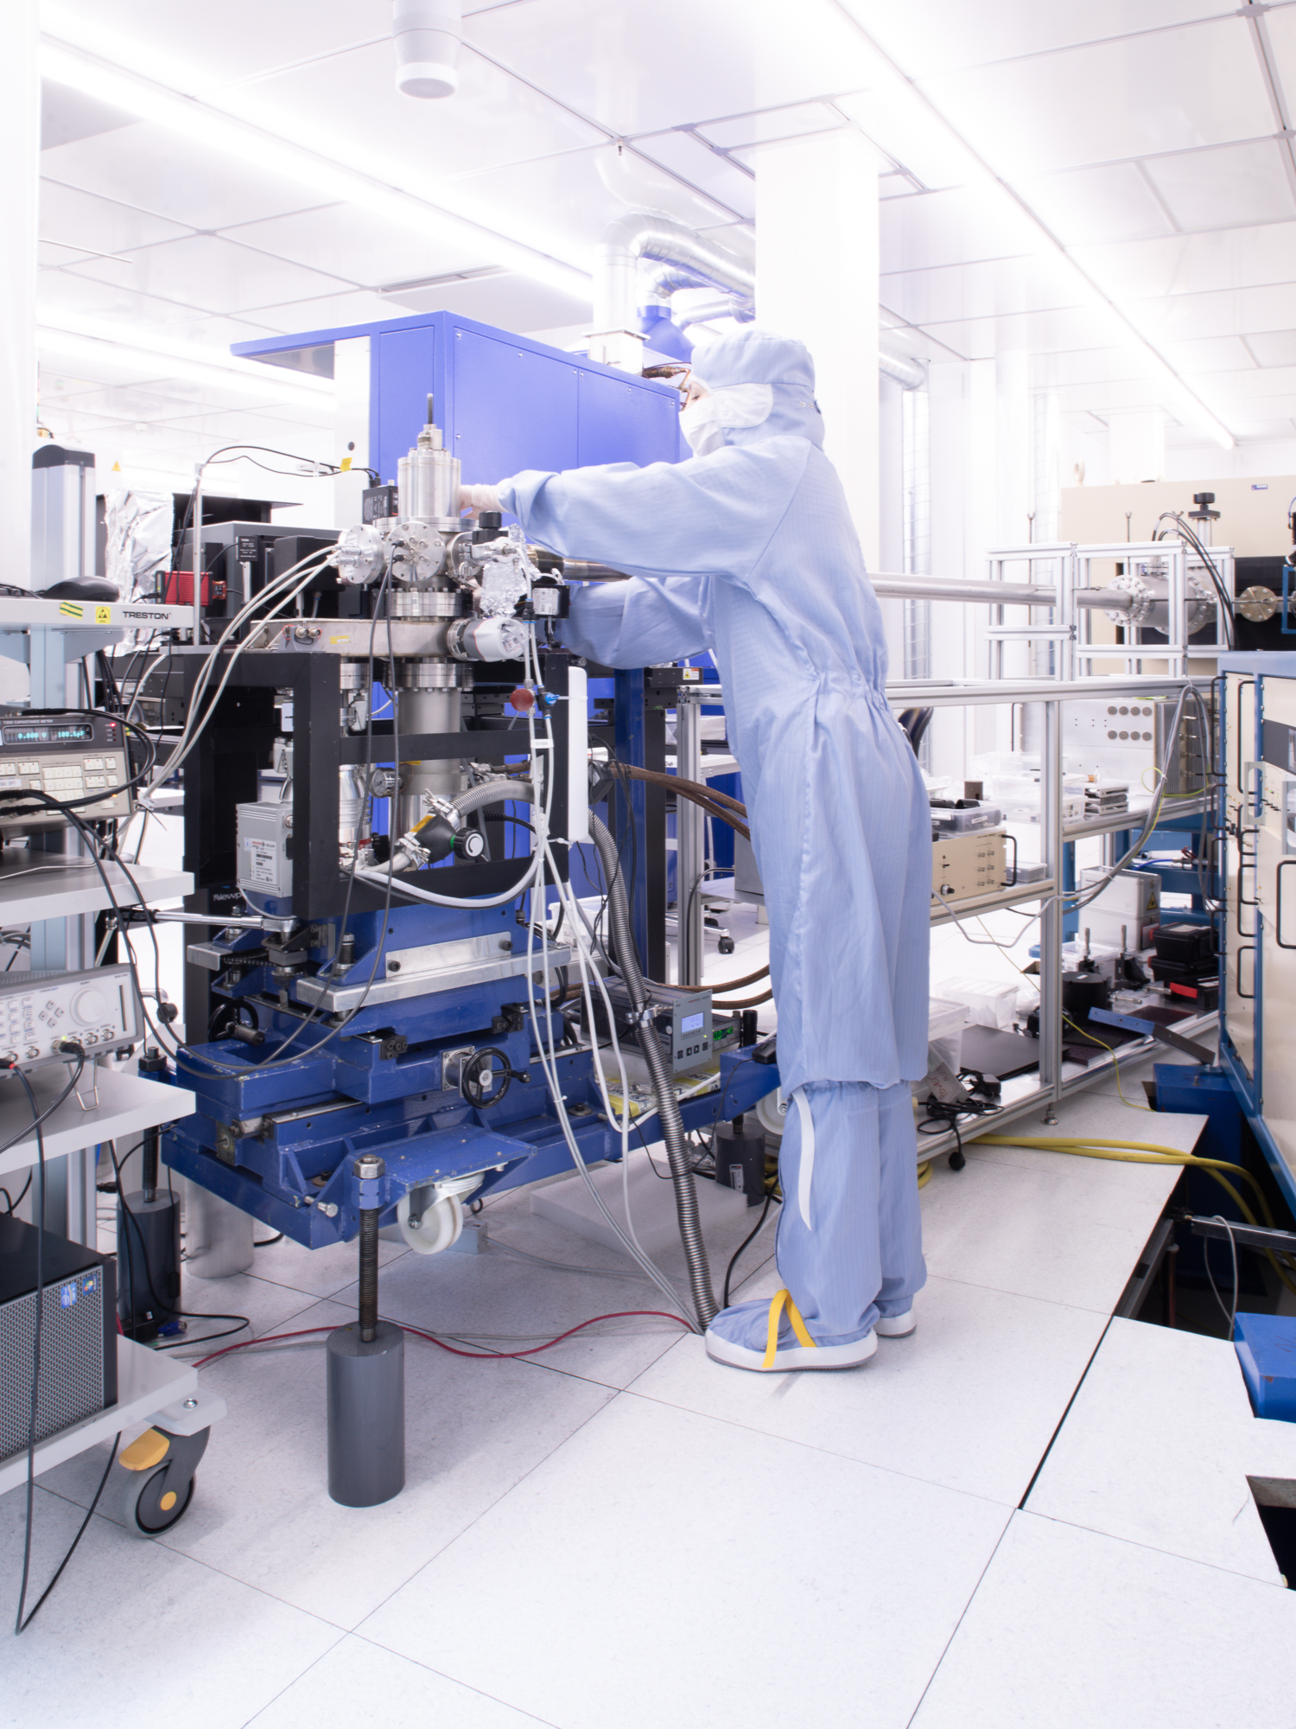

Predicting solid state material platforms for quantum technologies
Dr. Marianne E. Bathen
University of Oslo
m.e.bathen@fys.uio.no
O. Hebnes, Ø. S. Schøyen, S. G. Winther-Larsen, L. Vines and M. Hjorth-Jensen
Notes:
Today I will talk about doping induced color centers in SiC, and how they can be applied to quantum technologies

Slide 2
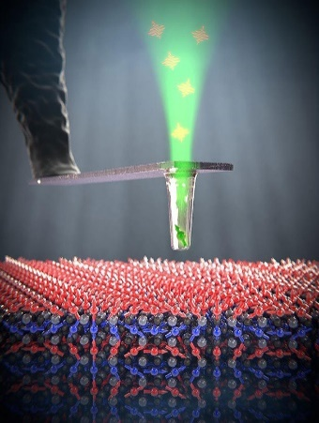

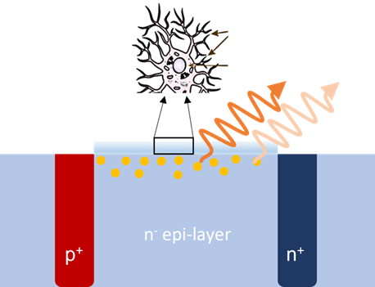

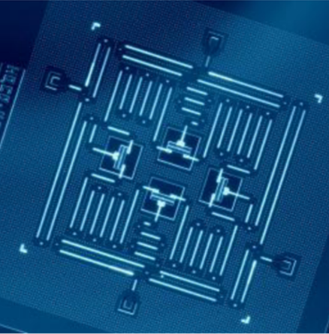
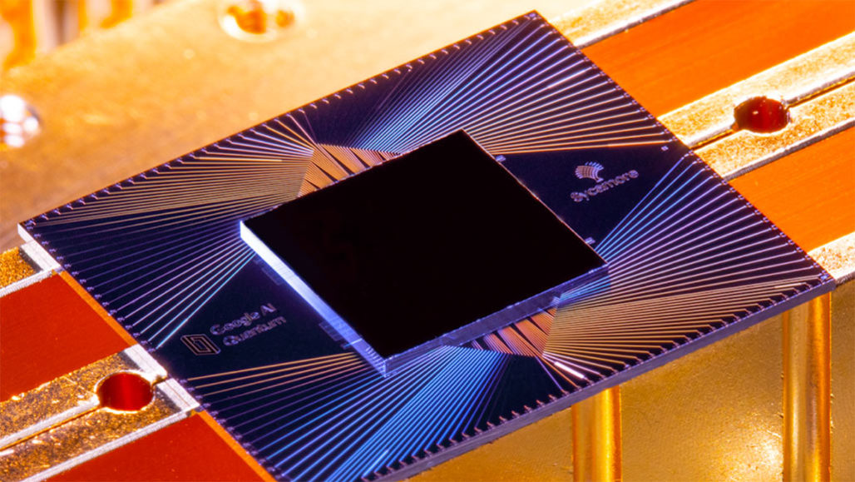
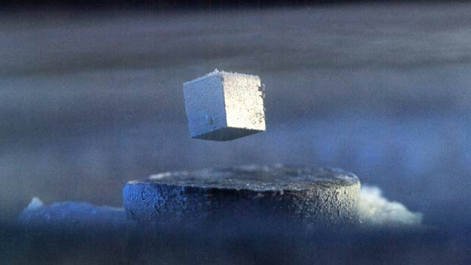
Quantum technologies promise new capabilities
Communi-cation
Computing
Sensors
https://qnami.ch/new-tools-promise-the-next-big-thing-for-quantum-sensing-photonics-media/
https://www.wired.com/sponsored/story/with-quantum-computings-rise-cybersecurity-takes-center-stage/
https://physicsworld.com/a/a-roadmap-for-the-quantum-internet/
https://en.wikipedia.org/wiki/Superconducting_quantum_computing
Credit: IBM
Credit: Google
Notes:
Gorpu into three categories.

Slide 3
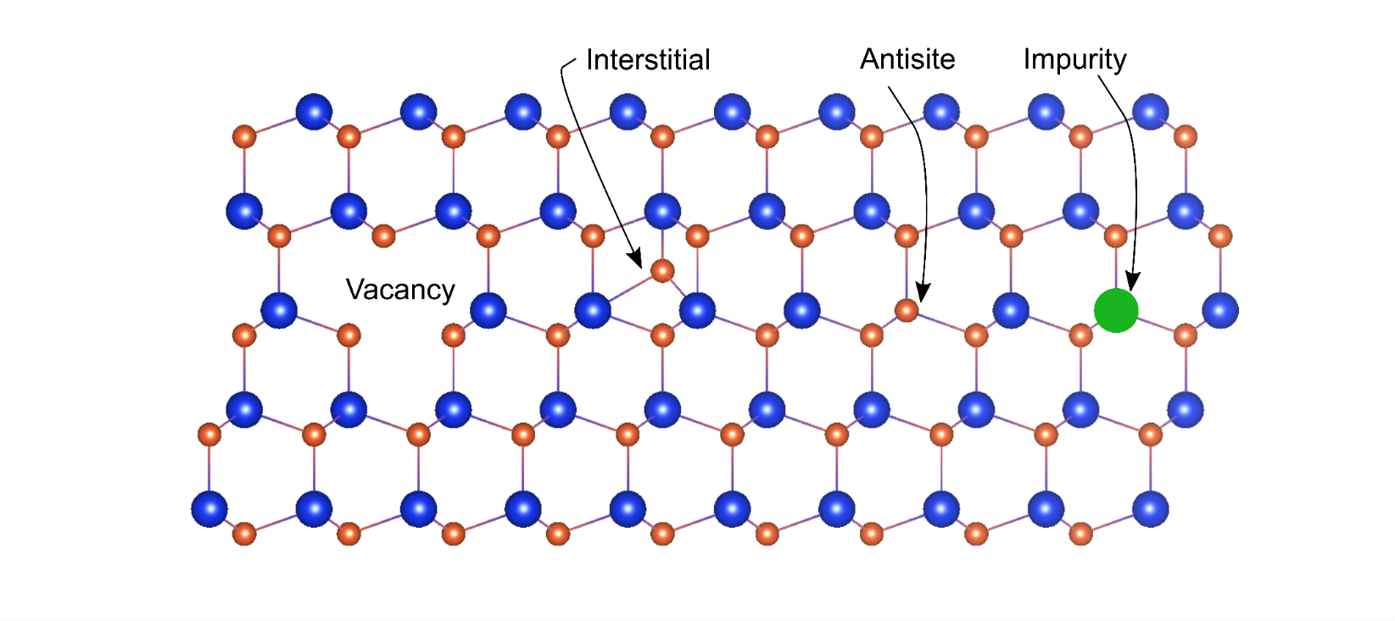
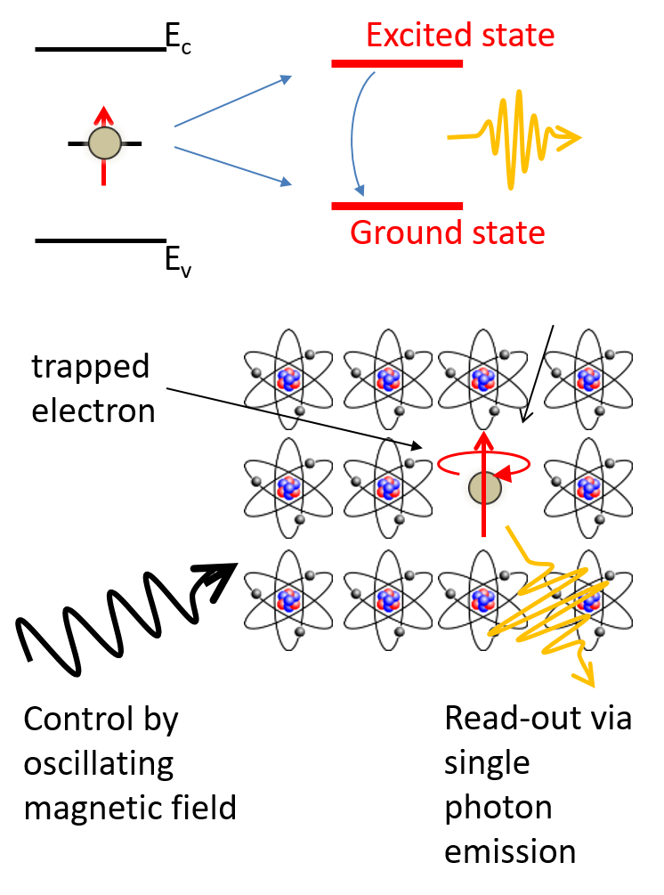
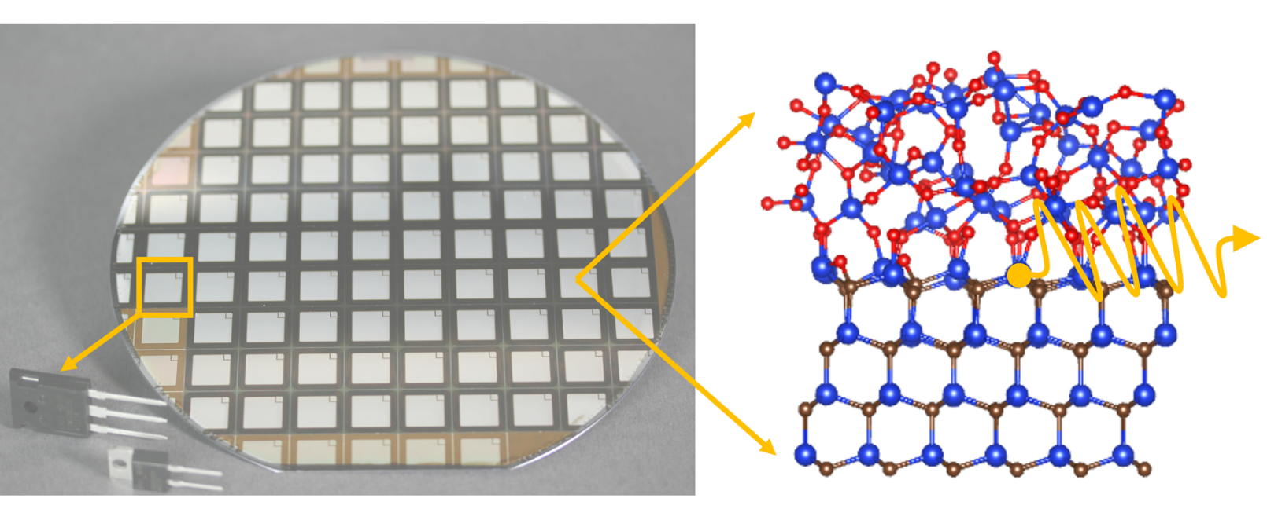
Semiconductors for quantum technologies
Notes:
Semiconductors are used in all electronics … Want semiconductor based QT because can leverage mature fabrication and semiconductor technoklogy, and get a semi isolated atom like state in the semiconductor band gap

Slide 4

Point defects in semiconductors for QT
Isolated electron spin
Single-photon emission
E_{c}
E_{v}
Excitons, quantum dots, ...

Slide 5
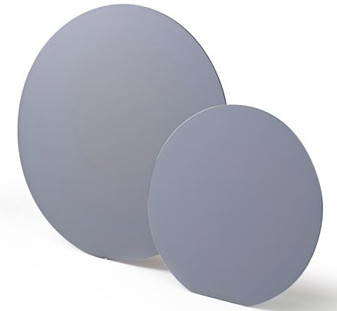
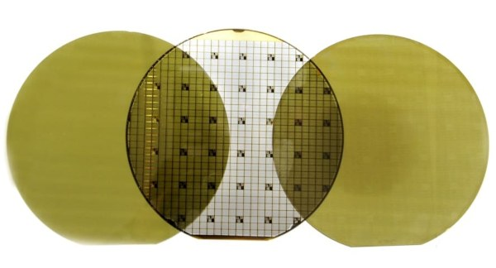
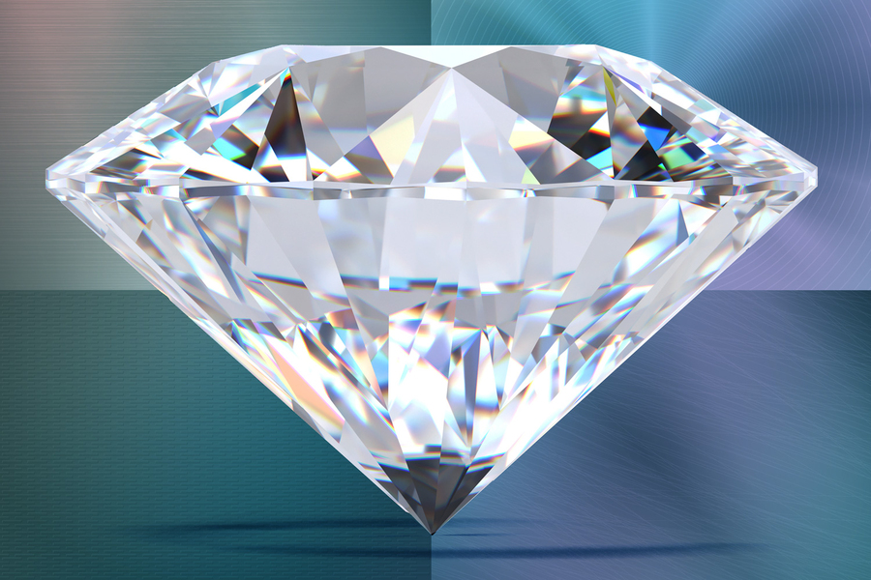
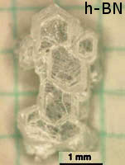
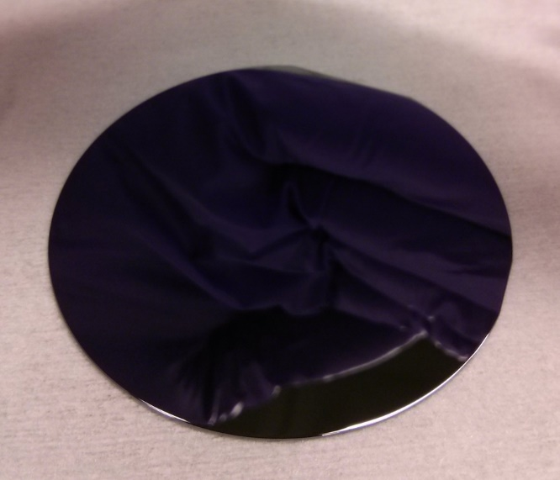
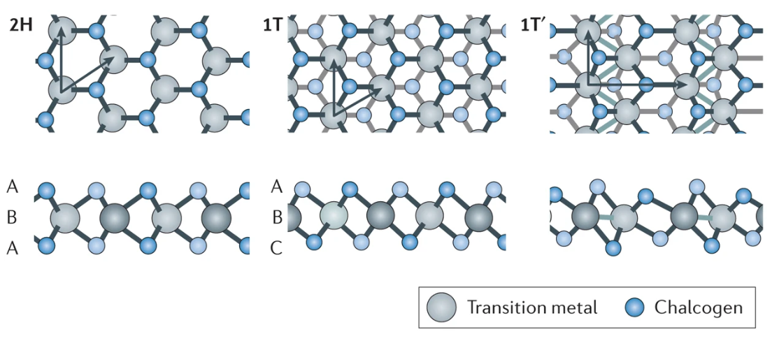
Semiconductor materials for QT
Silicon
Point defects
Spin qubit CMOS devices
Silicon carbide
Point defects
Diamond
Point defects
Gallium arsenide
Quantum dots
2D-TMDCs
Bound excitons
Hexagonal boron nitride
Point defects
Notes:
Although platforms exist, still scarce
Also, dont understand why in some materials, and not in others

Slide 6
Agenda
1. Materials Informatics
2. Machine learning for materials search
3. Predicting new materials for QT

Slide 7
Agenda
1. Materials Informatics
2. Machine learning for materials search
3. Predicting new materials for QT

Slide 8
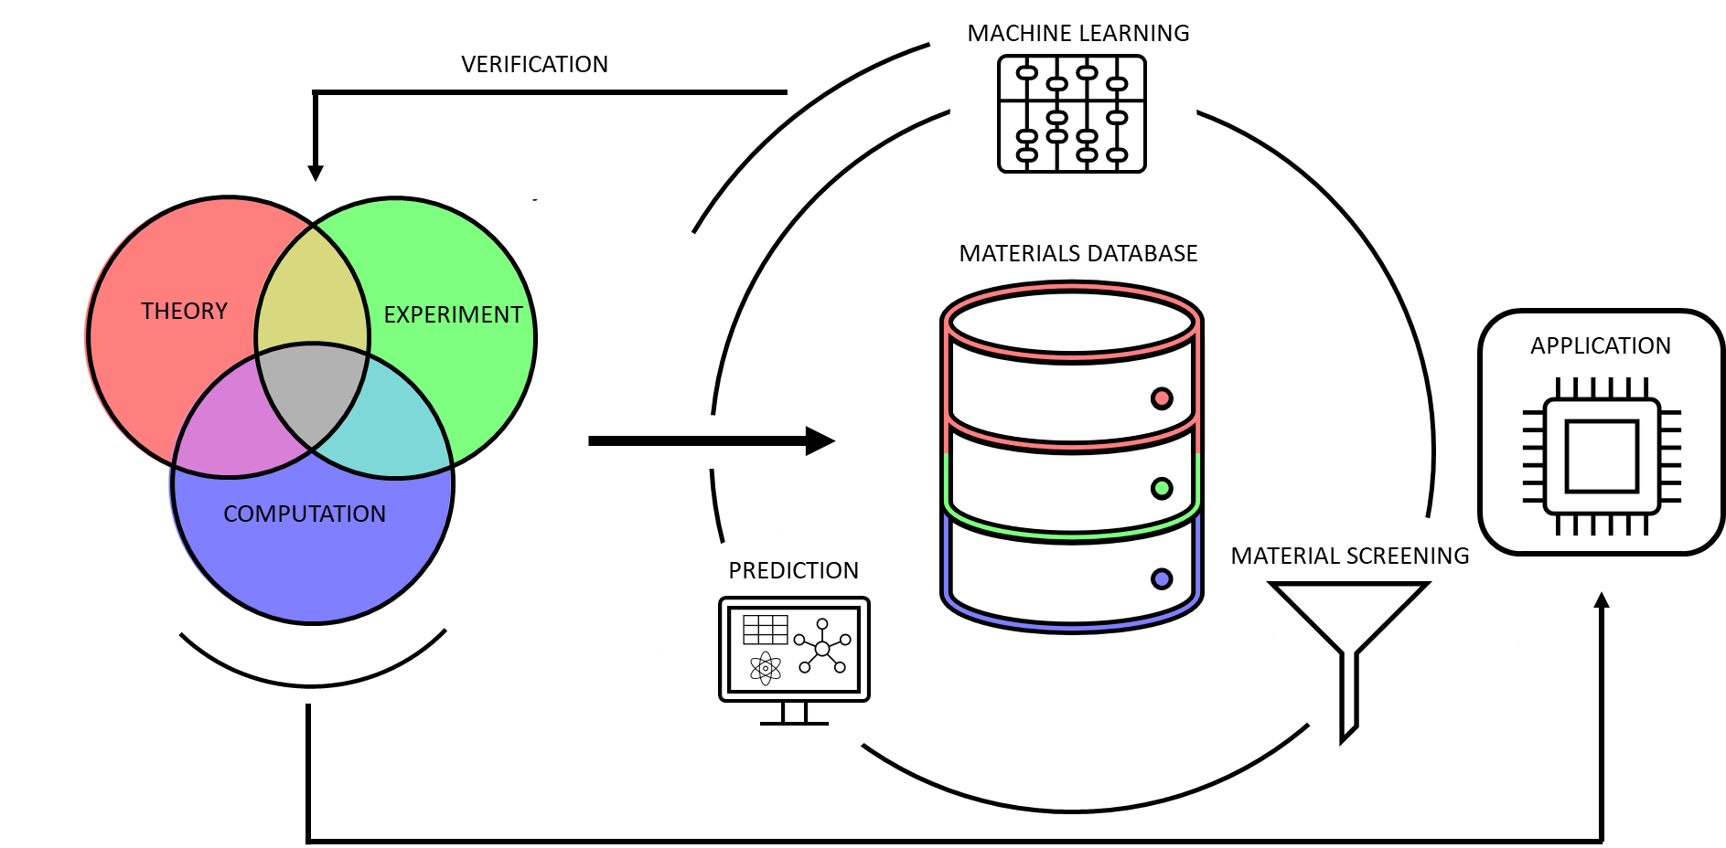
Materials Informatics Workflow
DOI: 10.1038/s41524-022-00888-3
Notes:
Now, although several examples exist, platforms are still scarce.
Also, the reason for why these characteristic manifest in certain cases and not others are not fully understood.
In this work we we employ targeted search using data mining and supervised machine learning for promising
material systems in which to expect QT compatible properties. Rather than searching through a host of signals
for those that match our criteria, we aim to predict which materials and signatures should be targeted for more
detailed studies
This is made feasible by the availability of databases
containing material properties for a wide range of different systems.

Slide 9
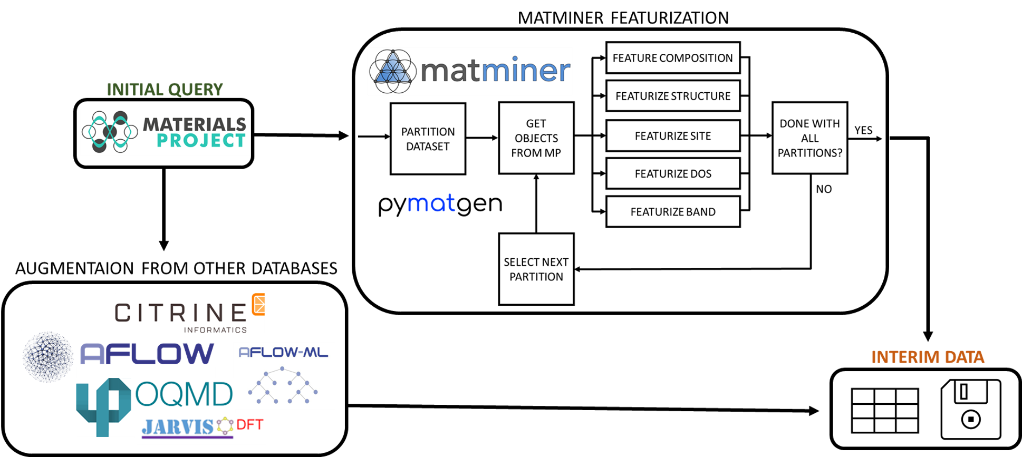
Information Flow
DOI: 10.1038/s41524-022-00888-3
Notes:
We start by extracting semiconductor entries in the Materials Project database [22, 23]. In this work, the data in question are provided
by bulk density functional theory (DFT) calculations to obtain the ground state properties of different elements and
compounds.
The DFT calculations in the database were performed using VASP and PBE.
The data from MP are checked against other databases to include additional information.
After material extraction tools from the open-source library Matminer [38] was applied to generate thousands of
features from the data. We will refer to this process as featurization. Focuses on a material’s composition, structure, atomic sites, density of
states and band structure.

Slide 10
Agenda
1. Materials Informatics
2. Machine learning for materials search
3. Predicting new materials for QT

Slide 11

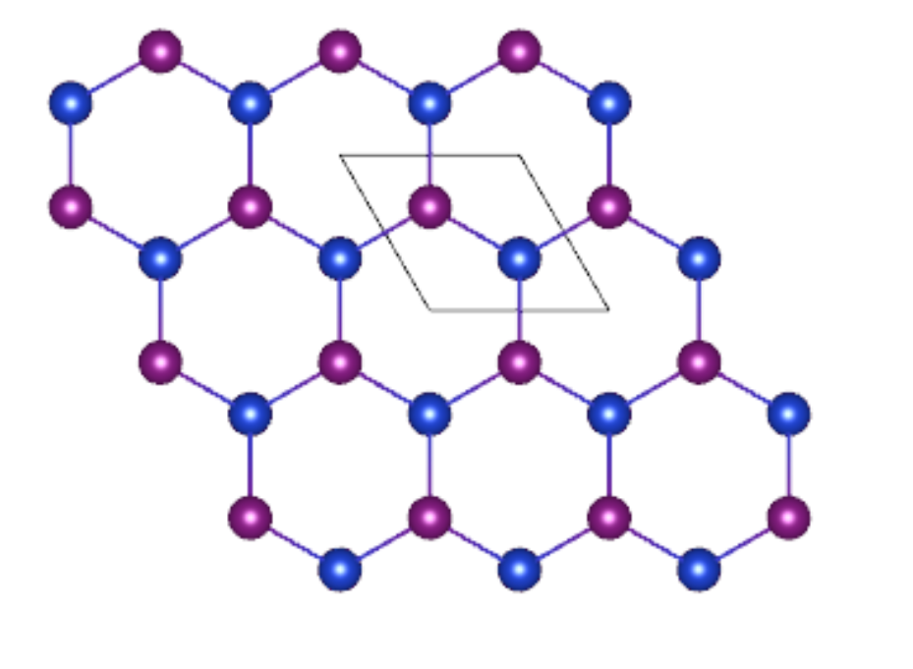
Input data is key
Materials project
Database for theoretical data
Density functional theory calculations
Input data to ML algorithms
Calculated properties of semiconductors
Unit cells (not defects)
PBE calculations (band gap)
Understanding pros and cons of input data is key!

Slide 12
Information Flow
Interim data 25.000 materials
Labeled data
Training set for ML
Test set for ML
Unlabeled data
Apply ML methods to predict QT candidates
Goal: Use machine learning to recognize and predict new material hosts for QT
Four supervised ML methods are employed:
Logistic regression
Decision trees
Random forests
Gradient boosting
Notes:
We are now left with an interim data set of around 25000 materials.
This dataset will now be divided into portions. One part iwll be labeled to train supervised machine learning algoriuthms on, and another portion will be left unlabeled to allow prediction of new candidate hosts for quantum technologies.

Slide 13
Approaches to data labeling
Criteria-based approach
Empirical approach
Criteria according to [1,2] for suitable qubit defect hosts
>50 % spinless isotopes
Non-polar space group
Non-magnetic
Band gap > 0.5 eV in MP (PBE)
Calculated to be stable in MP
Pragmatically remove toxic, radioactive, etc materials
Unsuitable materials follow opposite criteria
Label suitable materials based on empirical evidence
Experimental findings
C, Si, SiC, hBN, GaAs, GaN, AlN
Theoretical predictions
ZnSe, AlP, GaP, AlAs, ZnTe, SiGe
Label 400 materials as unsuitable according to the criteria-based approach
[1] J. Weber, et al., PNAS (2010).
[2] A. M. Ferrenti et al., npj Computational Materials 6, 126 (2020).

Slide 14
Agenda
1. Materials Informatics
2. Machine learning for materials search
3. Predicting new materials for QT

Slide 15
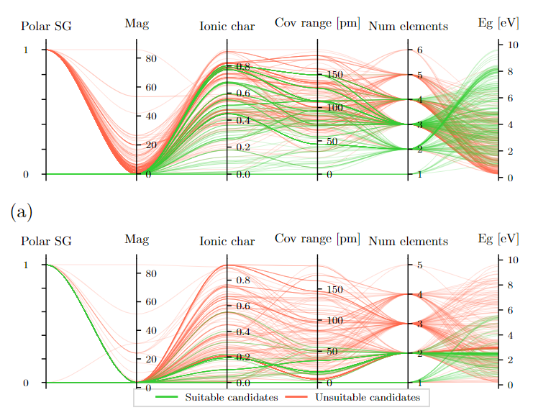
Analysis of the labeled datasets
Suitable and unsuitable candidates span roughly same parameter space for criteria-based approach
Clearer distinction for empirical approach
Suitable candidates in the empirical approach have
Ionic character between 0 and 0.2
Covalent range between 0 and 50
One or two elements in the composition
Criteria-based approach
Empirical approach
DOI: 10.1038/s41524-022-00888-3
Notes:
parallel coordinate plots for selected features informed by the criteria proposed by Weber et al. [8]. Parallel coordinate schemes [65, 66] represent a multi-dimensional data tuple as one polyline crossing a parallel axis. The selected features are found on the x-axis,
while the y-axis shows the value of the data. Thus, parallel coordinate plots can turn complex many-dimensional
data into a compact two-dimensional representation. Due to possible data cluttering, the figure visualizes a random
sample of each class (suitable or unsuitable) with an upper limit of 250 per class with transparent lines. The green
and red polylines represent suitable and unsuitable candidates, respectively.

Slide 16
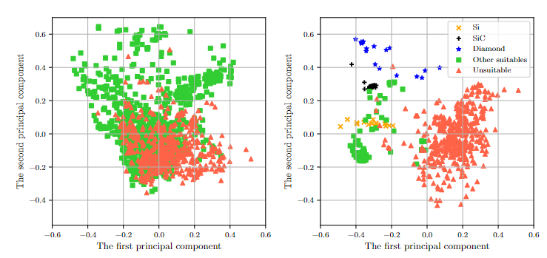
Analysis of the labeled datasets
Criteria-based approach
Empirical approach
Empirical approach:
Clear separation between suitable and unsuitable candidates
Si, SiC and diamond related entries are grouped in separate regions
Criteria-based approach:
Suitable and unsuitable candidates overlap
Selected criteria not sufficient for clear separation
DOI: 10.1038/s41524-022-00888-3
Notes:
Lets have a look at the materials in the training set themselves, to see if the distinction between suitable and unstuiable makes sense.
To reduce the dimensionality of the labeled data a principal component analysis (PCA) was performed. We
identify the two largest eigenvalues of the covariance matrix [19] of the complete initial dataset from the MP database,
and transform the labeled datasets according to the corresponding two eigenvectors. Red triangles represent unsuitable candidates while
otherwise colored symbols (green, blue, black and yellow) represent suitable candidates.
Firstly, we observe that the suitable and unsuitable candidates overlap for the Ferrenti approach, due to the complexity of reducing many features to two. The logic behind categorizing materials in two classes (suitable and unsuitable) appears to
not translate into a distinct separation. We therefore expect that the Ferrenti
approach could need supplementary dimensions for further distinguishing between the materials in the two categories or the criteria were not based on correct assumptions.
In the case of the empirical approach, on the other hand, a clear trend can be discerned
This strongly indicates that the empirical approach may be capable of separating materials based on their underlying properties, as suitable or unsuitable for QT.

Slide 17
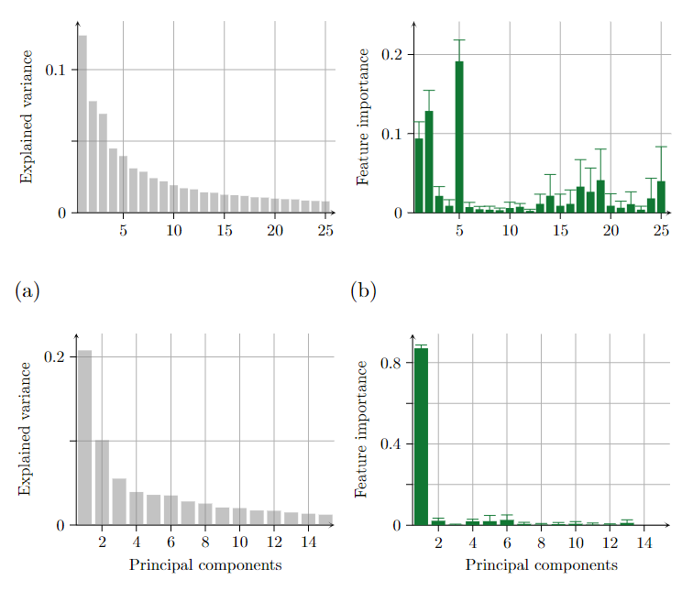
Machine learning: Evaluation
Criteria-based approach
Four ML methods are trained on the training set:
Logistic regression
Decision trees
Random forests
Gradient boosting
Perform validation on the test set
The criteria-based approach needs 144 principal components to reach 95 % accumulated explained variance
For the empirical approach, just a few PCs are needed
Empirical approach better suited
Empirical approach
DOI: 10.1038/s41524-022-00888-3
Notes:
Next the ML methods are trained and validated on the labeled training and test sets, respectively. We employ four supervised machine learning algorithms and only accept a material as supervised if all four methods agree to a certain threshold:
The ML methods employed herein are logistic regression, decision
trees, and the ensemble methods random forests and gradient boosting
Evaluation of the ML methods reveals that the empirical approach reaches high explained variance with just a few principal components as opposed to the Ferrenti approach, confirming that the empirical approach to data labeling is likely better suited for separated suitable and unsuitable candidates in this framework.

Slide 18
Machine learning: Principal component analysis (PCA)
Criteria-based approach
The most important PCs for the criteria-based approach are nr. 5 and 2
5: Band gap computed by DFT
2: Contributions from the covalent radius, the ionic character and the packing efficiency
Most important PC for empirical approach is nr. 1. Corresponding features include
Bond orientational parameters
Coordination numbers
The radial distribution function of a compound’s crystal system
Empirical approach
DOI: 10.1038/s41524-022-00888-3
Notes:
Again performing a principal component analysis, but now of the training sets separately, allows us to distinguish which physical features the machine learning methods are finding important upon training.
We find that the most important principal component in the Ferrenti approach is the fitfth (fifth largest eigenvalue). The trend is maintained for all four ML methods. By selecting the highest values in this eigenvector we find that the corresponding
features originate from the band gap, as expected from the initial criteria. The second most
important principal component contains contributions from the covalent radius,
the ionic character of the bonding, and the packing efficiency of the atoms.
Empirical;
The distinct importance of
the first principal component partly explains why we experience a high accuracy for only a single component. The first
principal component’s corresponding features is a complex combination of several material properties, but we find that
it includes bond orientational parameters such as bond angle and length, coordination numbers, and the radial distribution function of a compound’s
crystal system. The standard deviation of the radial distribution function appears multiple times in the list of features
and is of particular importance.

Slide 19
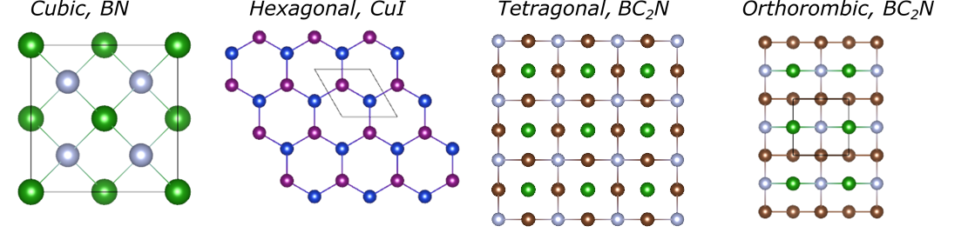
Machine learning: Predicting material candidates
Approach | Confidence | Material | Crystal structure | Band gap (eV)
Empirical | 0.85 | CdSe | Hexagonal | 0.6
Empirical | 0.85 | CuI | Hexagonal | 1.2
Empirical | 0.85 | CuI | Cubic | 1.2
Empirical | 0.85 | CdSe | Cubic | 0.5
Empirical | 0.85 | BN | Cubic | 4.6
Empirical | 0.85 | InAs | Cubic | 0.3
Empirical | 0.85 | ZnCd₃Se₄ | Cubic | 1.7
Empirical | 0.85 | BC₂N | Tetragonal | 1.6
Empirical | 0.85 | BC₂N | Orthorombic | 1.8
DOI: 10.1038/s41524-022-00888-3

Slide 20
Machine learning: Predicting material candidates
Approach | Confidence | Material | Crystal structure | Band gap (eV)
All | 0.75 | CdSnP₂ | Tetragonal | 0.7
All | 0.75 | GeSe | Cubic | 0.4
All | 0.75 | InP | Cubic | 0.5
All | 0.75 | InP | Hexagonal | 0.5
All | 0.75 | SiSn | Cubic | 0.4
All | 0.75 | ZnGeAs₂ | Tetragonal | 0.6
DOI: 10.1038/s41524-022-00888-3

Slide 21
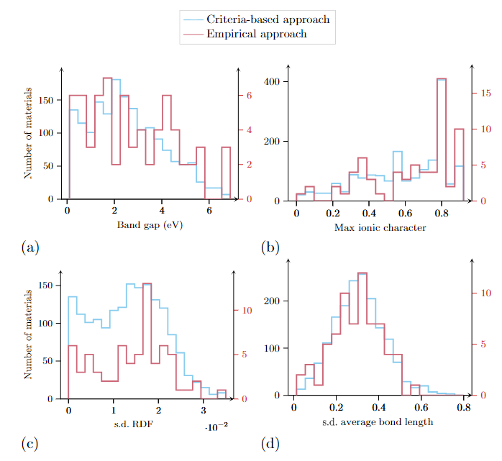
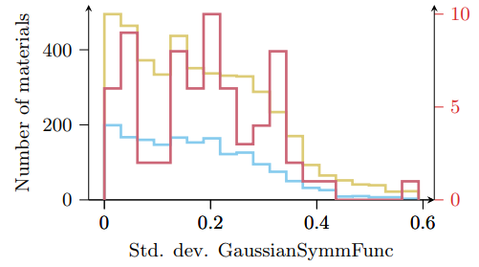
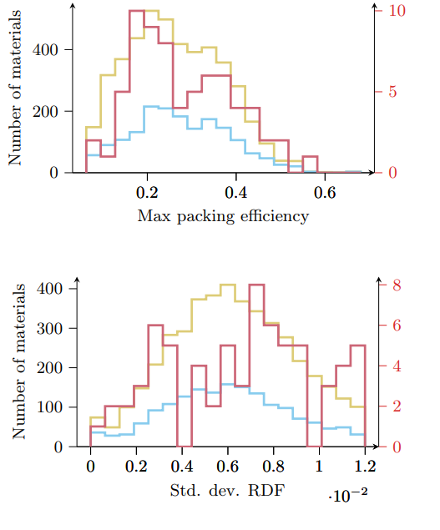
Predicting material candidates: parameter distribution
DOI: 10.1038/s41524-022-00888-3
Notes:
The analysis of the principal components extracted from the ML methods revealed that the most
important principal component for the Ferrenti approach encompasses features related to the band gap and ionic character of bonding, while the empirical instead focuses on features rleatred to rystal symmetry and bonding length and angle.
It is also for this type of feature that we observe a substantial difference in the distribution of materials as a function of a certain property between the two approasches, and likely explains the clearer separation between suitale and unsuitable candidates in the training sets.
The importance of symmetry and bonding related features over band gap and ionic character presents a certain contrasts to eexpeictations from the literature.
Interestingly, although a certain degree of symmetry is present in all predicted materials, it seems that perfectly symmetric systems are not ideal for QT based on the material distributions as a function for instance the bond length and orientation. However, this is in agreement with experimental observations, as Known QT candidates typically exist in environments that are not perfectly symmetric . E.g., quantum defects in silicon and diamond are mostly impurities, while intrinsic defects in silicon carbide to exhibit quantum compatible effects. This is speculation
Definitiely, further studies are needed to investigate these asdpects.

Slide 22
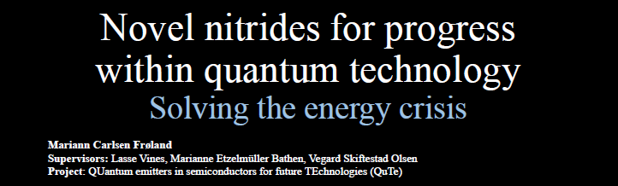

Using database search to guide experimental work
Growth of predicted quantum materials using sputtering
AlN
C-BN
ZnGeN₂
Make defects by ion implantation
Look for single photon emission and spin centers

Slide 23
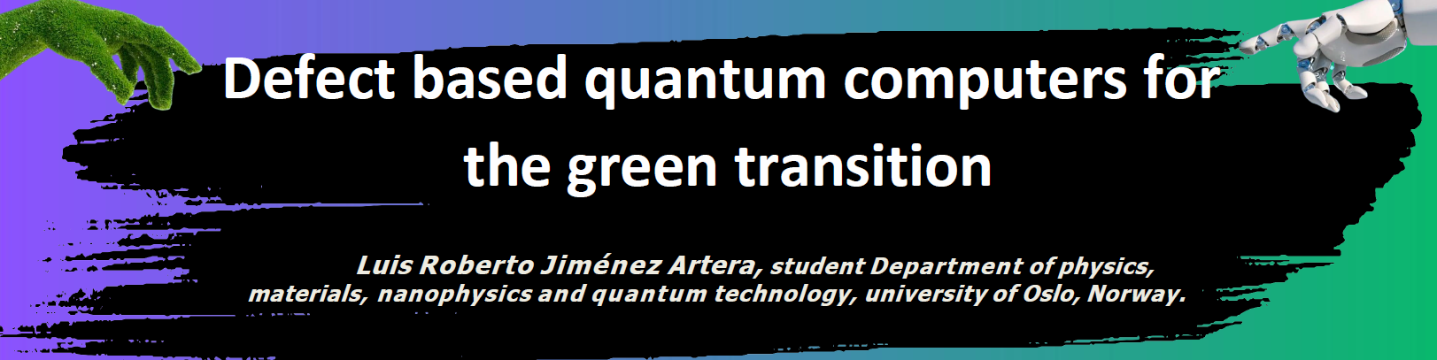
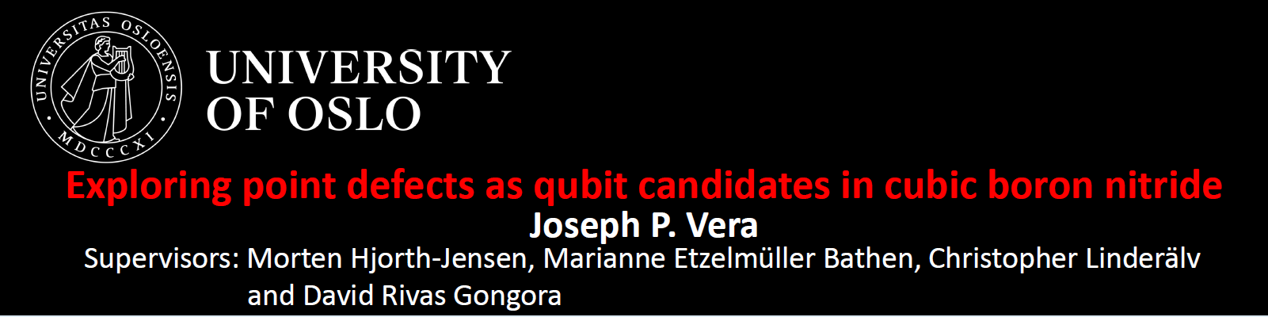
Using database search to guide in-depth theoretical studies
Density functional theory calculations
Defects in AlN
AlN
Density functional theory calculations
Defects in c-BN

Slide 24
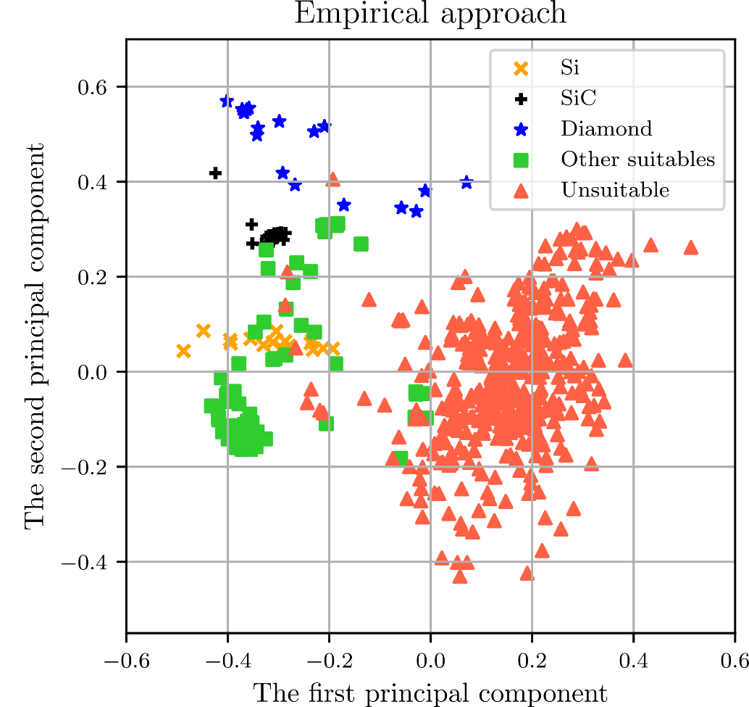
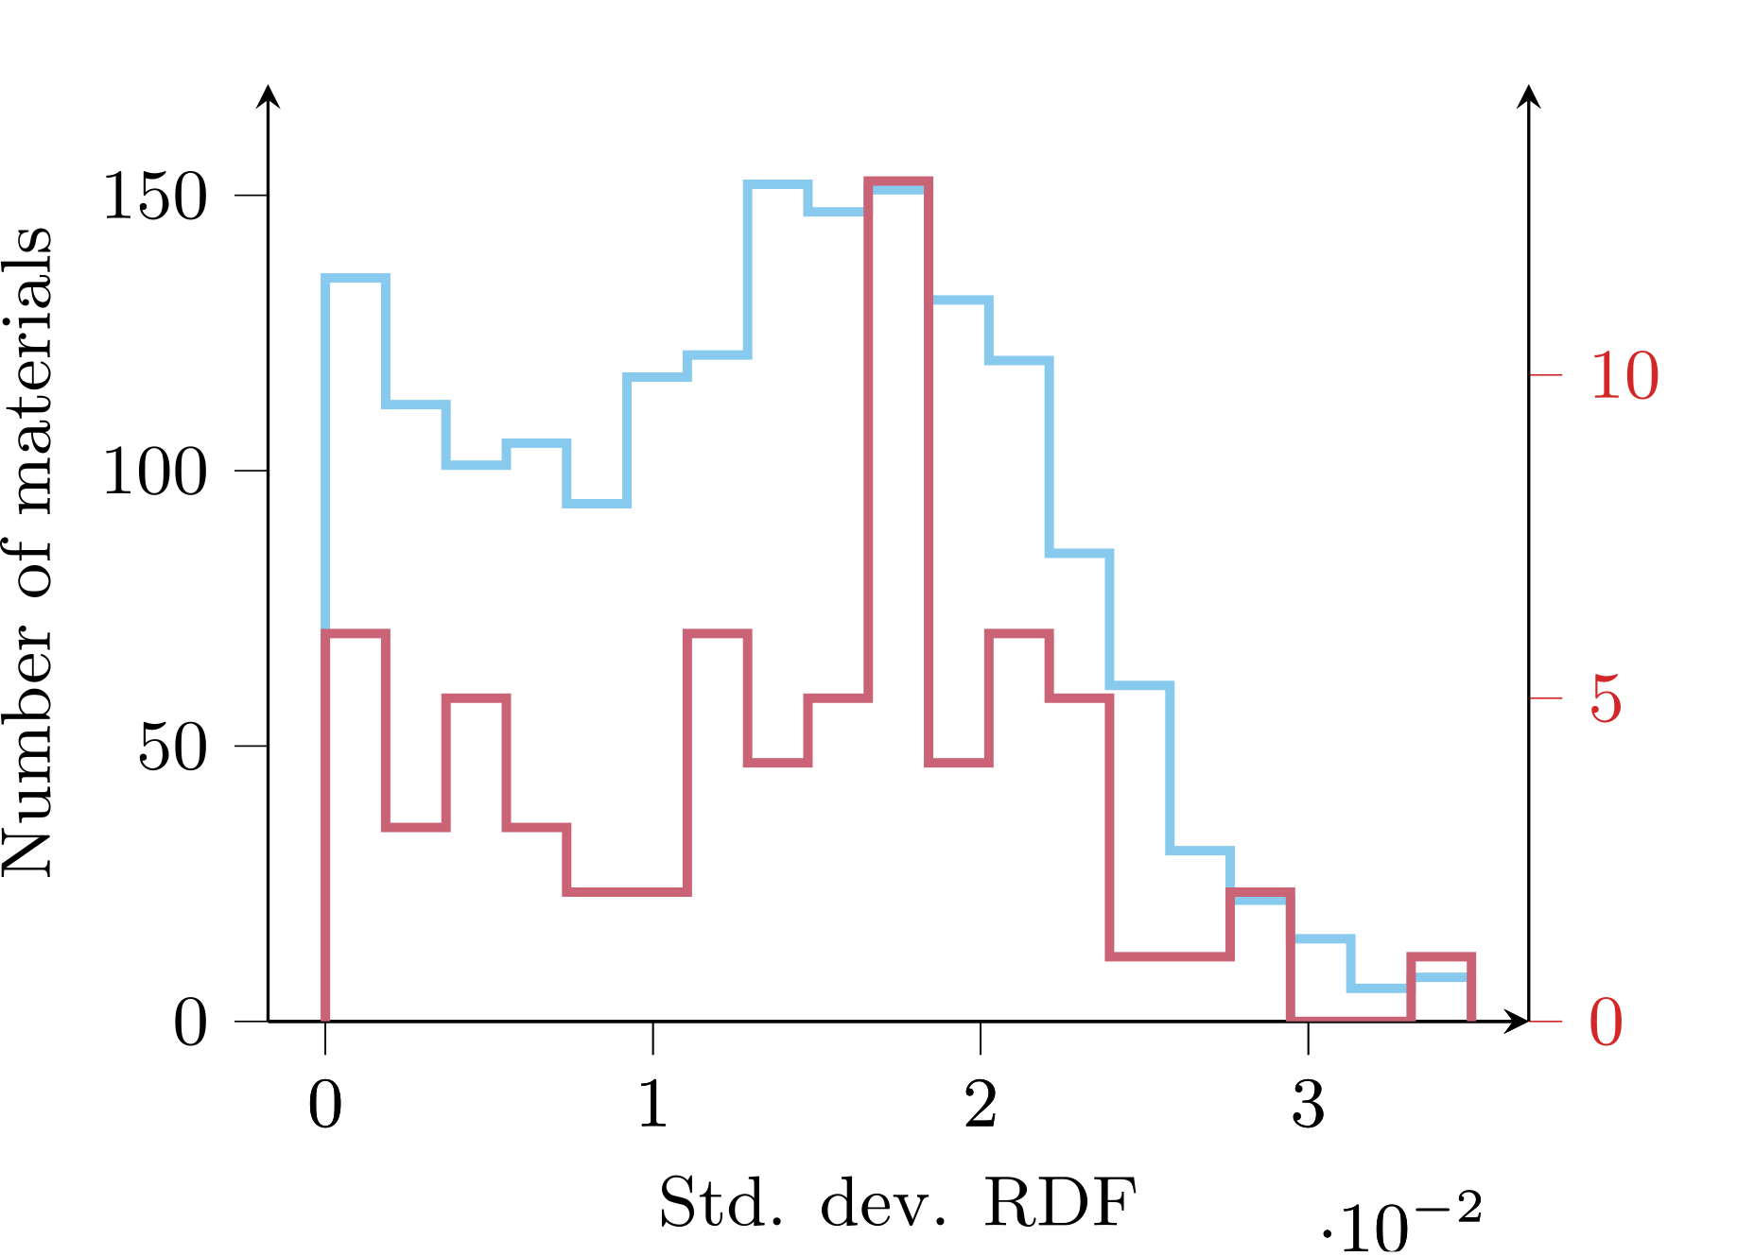
This methodology allows us to …
Classify materials according to their suitability for an application
Predict new material candidates for an application, here QT
Elucidate which material properties are playing a role
DOI: 10.1038/s41524-022-00888-3
Notes:
To summarize, we have developed data extraction tools and strategies for data mining and labeling to enable
the automated search and analysis of host materials for QT
The empirical approach exhibits clear separation between suitable and unsuitable candidates and seems to capture some fundamental part of the underlying physics behind, as The previously expected traits, band gap and ionic character, cannot explain the observations alone.
We predict a number of candidate materials that are interesting fr further study, and propose that features related to the crystal structure, symmetry and bonding directionality are equally important.

Slide 25

Thank you for the attention!
Questions?

Slide 26
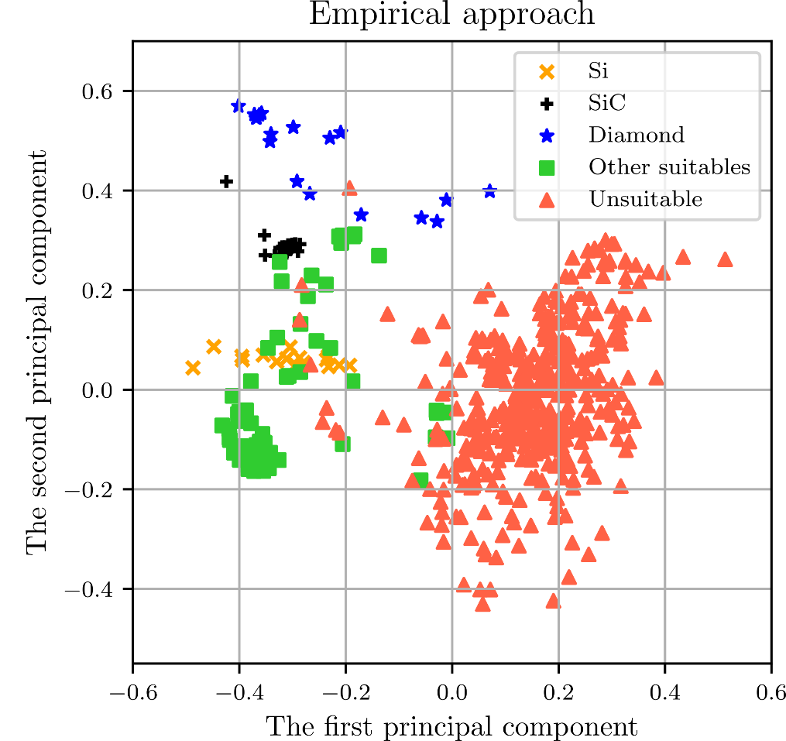
Brainstorming
Take 2 minutes to think among yourselves
How can this methodology be applied in your research?
What databases with experimental or theoretical data relevant to you?
Are there any material properties you would like to explore?
Prediction of new materials, nanostructures, phases, etc?

